Slide 1
Welcome to Our Presentation
Presentation
on
IP Address and Class (A, B, C & D), IPv6

Slide 2

Presenter info
Md. Sirajul Islam
Roll-06
Md. Solaiman Gazi
Roll-07
PGDICT4D
11th Batch
Networking and Data Communication Module
Group Member
Dr. Mohammad Kamruzzaman
Roll-08
Joytan Roy
Roll-09
Abu Taher Mia
Roll-10

Slide 3
IP address:
IP address definition:
An IP address is a unique address that identifies a device on the internet or a local network. IP stands for "Internet Protocol," which is the set of rules governing the format of data sent via the internet or local network.
What is an IP?
An IP address is a string of numbers separated by periods.
IP addresses are expressed as a set of four numbers.
Example:
address might be 192.158.1.38.
Each number in the set can range from 0 to 255.
So, the full IP addressing range goes from 0.0.0.0 to 255.255.255.255.

Slide 4

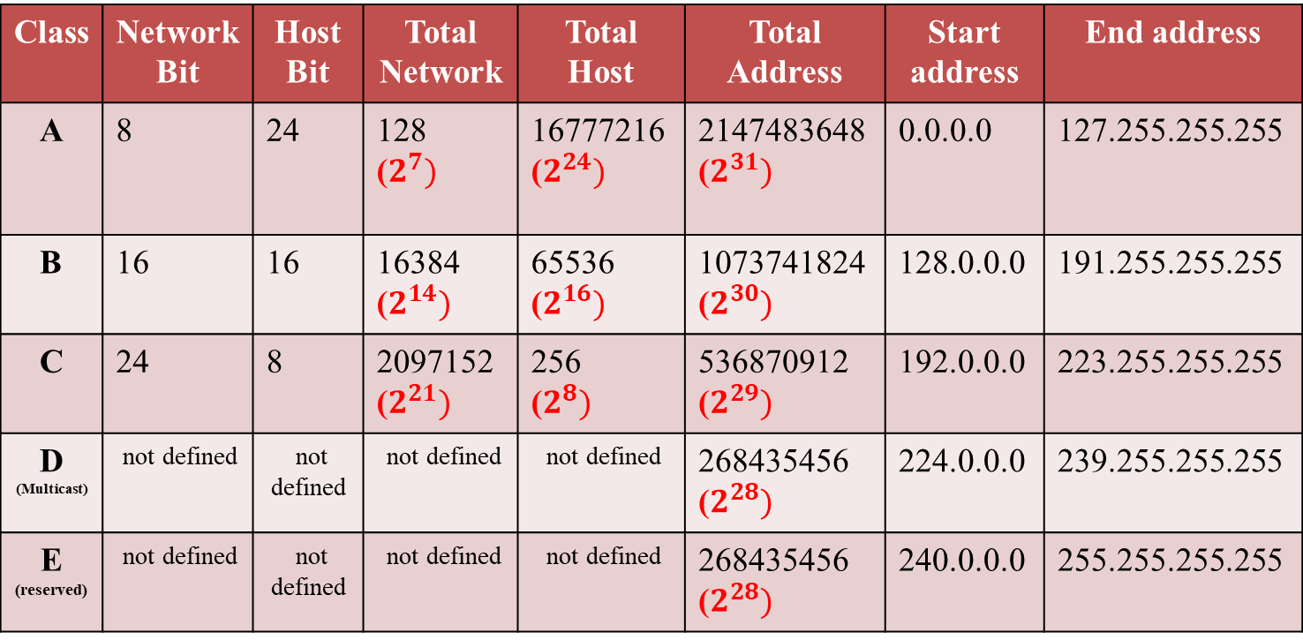
IP Address Classes:
There are two versions of IP addresses IPv4 and IPv6. I will discuss how IPv4 organizes IP addresses. IPv4 are 4,294,967,296 IP addresses. These addresses are organized into five IP classes. These classes are-
Class | Network Bit | Host Bit | Total Network | Total Host | Total Address | Start address | End address
A | 8 | 24 | 128 ($2^{7})$ | 16777216 ($2^{24})$ | 2147483648 ($2^{31})$ | 0.0.0.0 | 127.255.255.255
B | 16 | 16 | 16384 ($2^{14})$ | 65536 ($2^{16})$ | 1073741824 ($2^{30})$ | 128.0.0.0 | 191.255.255.255
C | 24 | 8 | 2097152 ($2^{21})$ | 256 ($2^{8})$ | 536870912 ($2^{29})$ | 192.0.0.0 | 223.255.255.255
D (Multicast) | not defined | not defined | not defined | not defined | 268435456 ($2^{28})$ | 224.0.0.0 | 239.255.255.255
E (reserved) | not defined | not defined | not defined | not defined | 268435456 ($2^{28})$ | 240.0.0.0 | 255.255.255.255

Slide 5
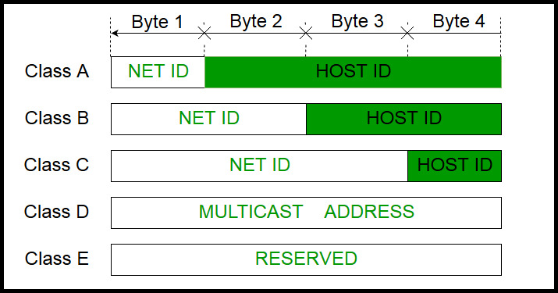
IP Address Classes:

Slide 6
IP Address Classes:
Class A :
The 1st eight bits or dotted decimal number of the network part and 2nd , 3rd & 4th twenty-four bits or dotted decimal number of the host part. Those are network called ‘Class A’ network. There are 128 possible Class A networks. Example- 0.0.0.0 to 127.0.0.0
Class B :
The 1st & 2nd sixteen bits or dotted decimal number of the network part and 3rd & 4th sixteen bits or dotted decimal number of the host part. Those are network called ‘Class B’ network. Example- 128.0.0.0 to 191.255.0.0
Class C :
The 1st , 2nd & 3rd twenty-four bits or dotted decimal number of the network part and 4th eight bits or dotted decimal number of the host part. Those are network called ‘Class C’ network. Example-192.0.0.0 to 223.255.255.0.

Slide 7

IP Address Classes:
Class D:
Class D addresses are used for multicasting applications
Class D is not used for "normal" networking operations.
Class D addresses have their first three bits set to “1” and their fourth bit set to “0”.
There are no host addresses within the Class D address space
All the hosts within a group share the group’s IP address for receiver purposes. Example-

Slide 8
IP Address Classes:
Class E :
Class E IP addresses are reserved for experimental and research purposes.
Its ranges from 240.0.0.0 – 255.255.255.254.
This class doesn’t have any sub-net mask.
The higher order bits of first octet of class E are always set to 1111.
28 bit
1 | 1 | 1 | 1 | Host ID

Slide 9
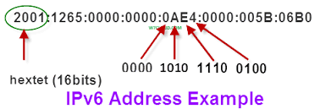
IPv6 address:
An IPv6 address is made of 128 bits divided into eight 16-bits blocks.
Each block is then converted into 4-digit Hexadecimal numbers (alphanumeric value) separated by colon symbols.
For example, given below is a 128 bit IPv6 address represented in binary format and divided into eight 16-bits blocks:
Binary: 0010000000000001 0000000000000000 0011001000111000 1101111111100001 0000000001100011 0000000000000000 0000000000000000 1111111011111011
Hexadecimal:- 2001:0000:3238:DFE1:0063:0000:0000:FEFB

Slide 10
Rule of IPv6
Even after converting into Hexadecimal format.
IPv6 address remains long.
IPv6 provides some rules to shorten the address.
The rules are as follows:
Rule-1:
Discard leading Zero(es).
See the Block 5 (0063), the leading two 0s can be omitted.
2001:0000:3238:DFE1:63:0000:0000:FEFB
Rule-2:
If two of more blocks contain consecutive zeroes, omit them all and replace with double colon sign ::, such as (6th and 7th block):
2001:0000:3238:DFE1:63::FEFB
Consecutive blocks of zeroes can be replaced only once by :: so if there are still blocks of zeroes in the address, they can be shrunk down to a single zero, such as (2nd block):
2001:0:3238:DFE1:63::FEFB

Slide 11
Types of IPv6 Addresses
Types of IPv6
Unicast
Multicast
Anycast
Unicast | A unicast address is used to refer to a single host. It is meant to send data to a single destination.
Multicast | A multicast address can be used to deliver a package to a group of destinations. Any packet sent to a multicast address, will be delivered to every host that has joined that particular group.
Anycast | The anycast address is very similar to the multicast address, but packets will be delivered to only one random host, instead of the entire group.

Slide 12

Thank You All

